Slide 1
Opposition Analysis:
Spain
Euro 2020 Quarterfinal V Switzerland
Spencer Hodapp

Slide 2
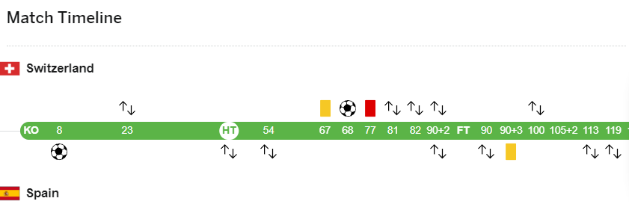
Major Match Highlights
‘8 Spain scores an Own Goal, engage a more passive style
‘23 – Embolo - SWISS {7, RW, Key Attacker} leaves the match with an injury
Spain Changes at the half, swapping Sarabia (22, LW) for Dani Olmo (19, LW)
54’Spain Change Morata(7,F) for Moreno(9,F) SPAIN
‘68 goal for Switzerland
‘77 straight red for Freuler (8, CM) SWISS
Match ends with SPAIN winning out in penalty kicks

Slide 3
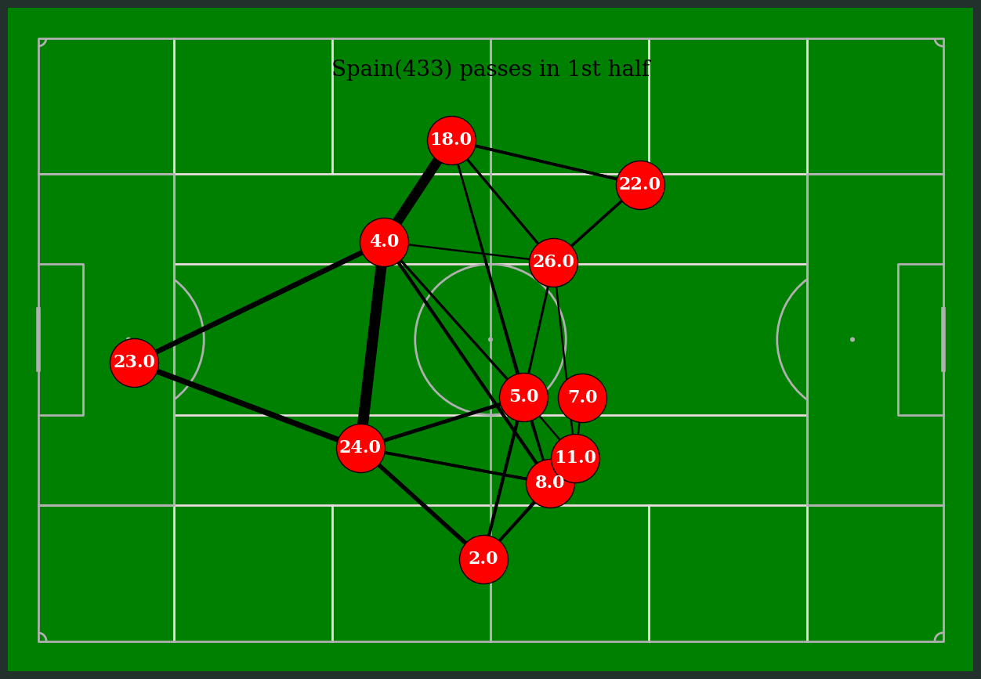
The first half is Spain's philosophy with an insecure lead
Jersey Number | Player
23 | Simon
24 | Laporte
4 | Torres
18 | Alba
2 | Azpilicueta
26 | Pedri
5 | Busquets
8 | Koke
22 | Sarabia
7 | Morata
11 | Torres
Typical Spain tiki-taka strategy of trying to establish control of the middle of the pitch, defense is very involved in the build up play
Attacking

Slide 4
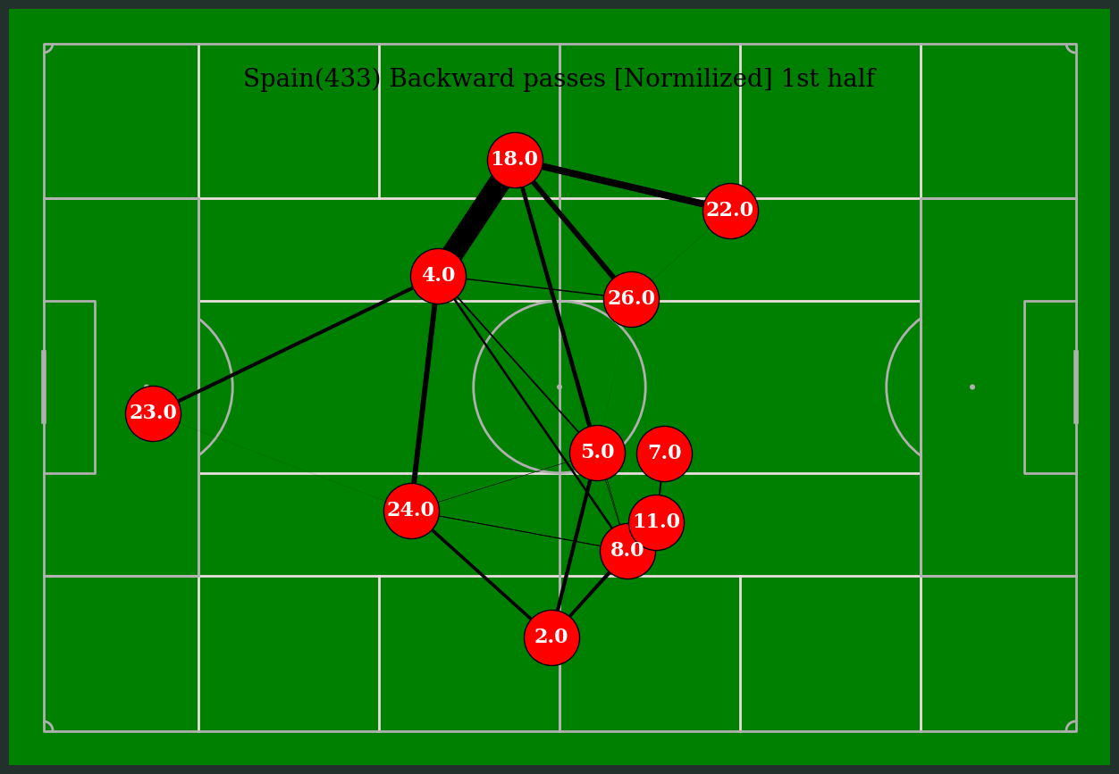
By weighting backward pass angles, we see left sided players are more likely to move the ball back to Alba. Alba seems to be the preferred safety valve from the attack, and Alba’ss safety valve seems to be Torres.
Jersey Number | Player
23 | Simon
24 | Laporte
4 | Torres
18 | Alba
2 | Azpilicueta
26 | Pedri
5 | Busquets
8 | Koke
22 | Sarabia
7 | Morata
11 | Torres
A possible strategic advantage could be gained by blitzing Alba(18) and looking to pick possession off Torres(4)
On the right, Azpilicueta(2) seems to be the safety valve however the connection back to Laporte is not as strong
Attacking

Slide 5
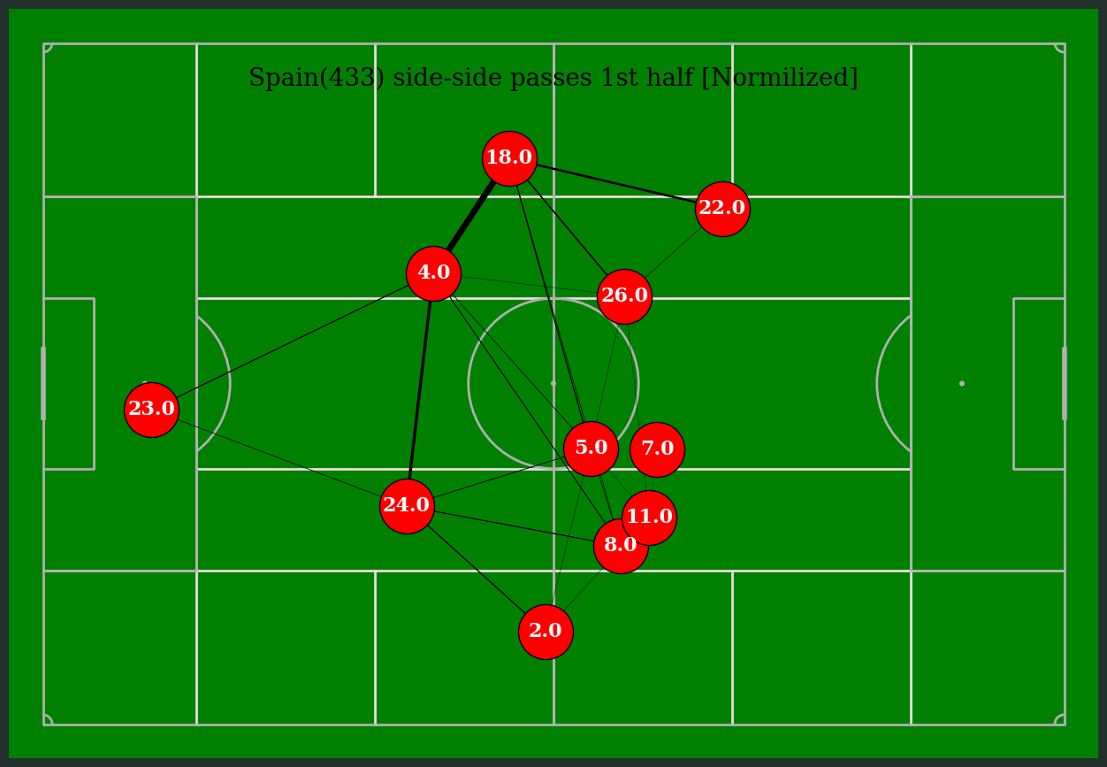
By weighting for side-to-side pass angles
Jersey Number | Player
23 | Simon
24 | Laporte
4 | Torres
18 | Alba
2 | Azpilicueta
26 | Pedri
5 | Busquets
8 | Koke
22 | Sarabia
7 | Morata
11 | Torres
Spain has no interest inside to side movement; they want front to back to create pockets to advance the ball not looking for gaps
Attacking

Slide 6
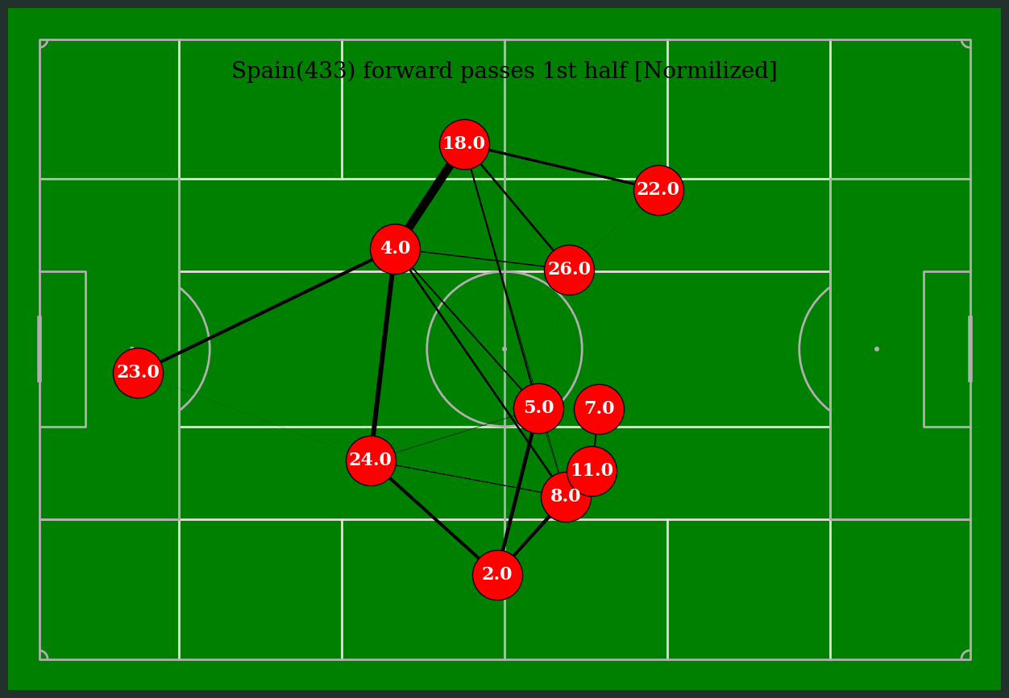
Azpilicueta seems to be more offensively minded with his touches, looking to play the ball forward, into the attack, the front line seems to collapse around Koke, indicating a wrinkle to further examine
Jersey Number | Player
23 | Simon
24 | Laporte
4 | Torres
18 | Alba
2 | Azpilicueta
26 | Pedri
5 | Busquets
8 | Koke
22 | Sarabia
7 | Morata
11 | Torres
Attacking

Slide 7
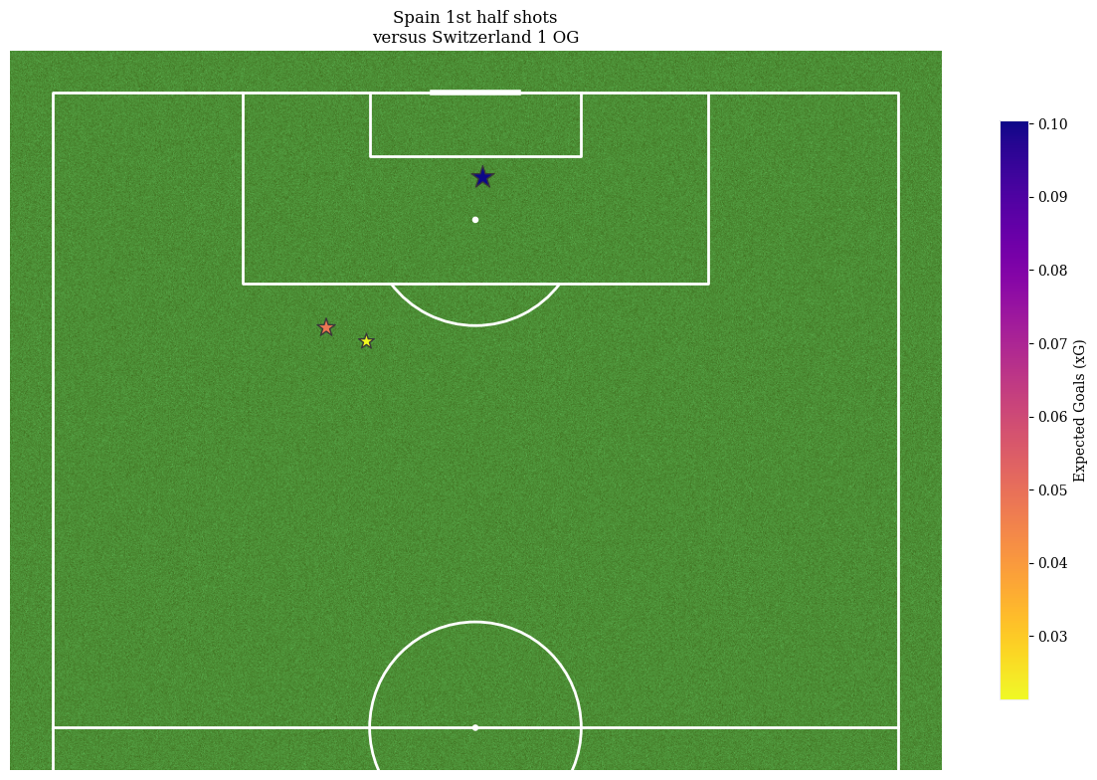
Spain first have shot map w/ xG
Post OG, Only two speculative shots outside the 18. Spain doesn’t want to give possession cheaply

Slide 8
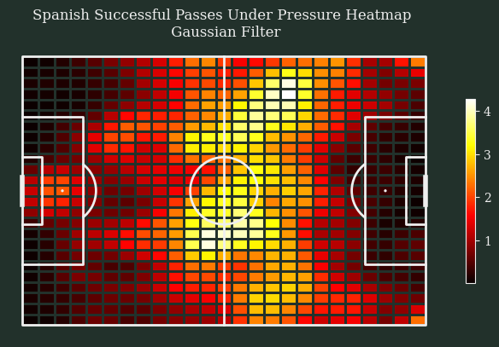
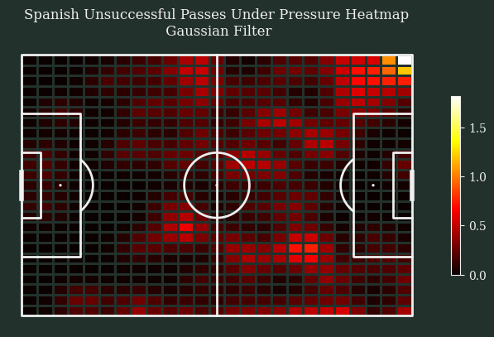
Switzerland first half pressure map
Clear to see that the top of Zone 14 was the hard point for the defense. Also note the attacking right side with all the forward passes being stopped on the diagonal of zone 14 and 12

Slide 9
Idea’s on how to approach Spain while chasing a led
Play up: With all the compression they want to do in the central third, look to play balls over the top in space into the attacking channel and force the CB to collapse on the ball position.
Out: Getting the ball out to the wings early will force Spain to vacate the central spaces, while players return to position defensively on the scramble look for channel passes
In: Once Spain must track back and out, look for second later runners into the box and exploit the confusion.

Slide 10
Switzerland Equalizes in the ‘68 and then in the ‘77 Freuler (8, CM) sent off with a RED
Halftime
This gives us a unique insight into how Spain presses the attack when actively searching for a goal, with an advantage, revealing the core attacking philosophy.

Slide 11
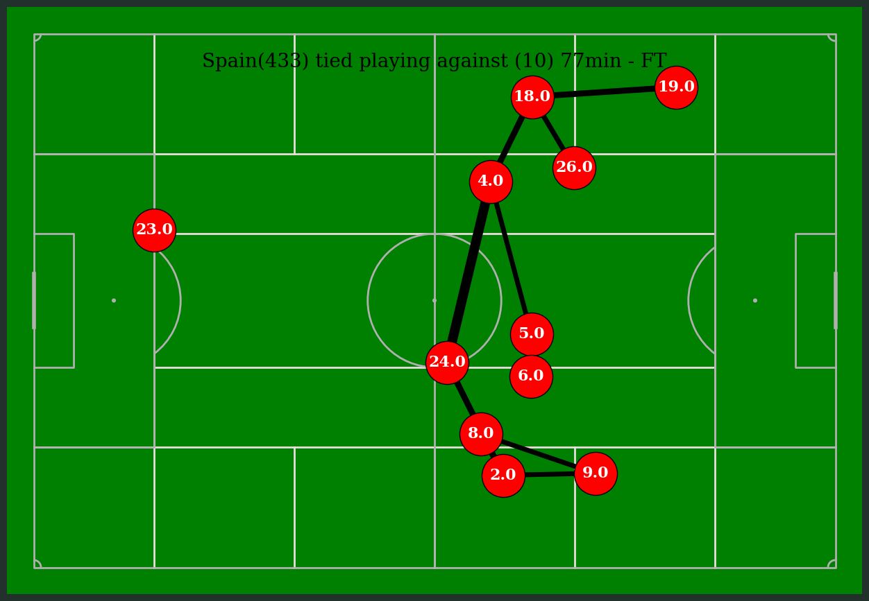
Spain passing map post red card ‘77
Number | Player
23 | Simon
4 | Torres
24 | Laporte
18 | Alba
2 | Azpilicueta
5 | Busquets
26 | Pedri
19 | Olmo
6 | Llorente
8 | Koke
9 | Moreno
Spain now try to occupy the final third, specifically working into zones 13 & 15 Note how high up the CB’s are. Laporte is farthest back, and he is on the half line

Slide 12
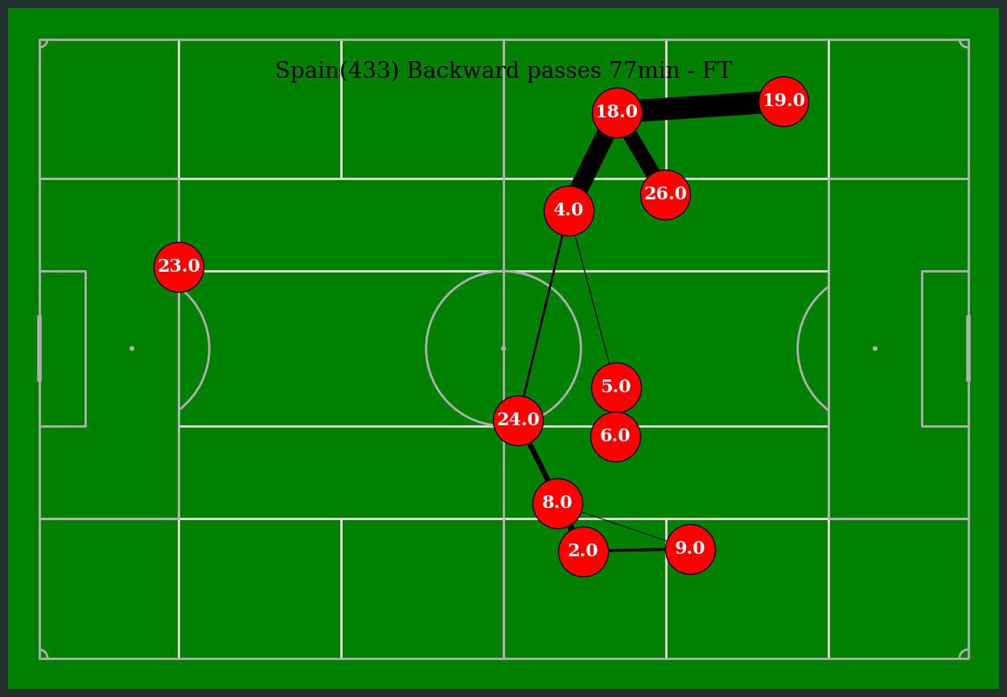
Spain Backwards passing map
Number | Player
23 | Simon
4 | Torres
24 | Laporte
18 | Alba
2 | Azpilicueta
5 | Busquets
26 | Pedri
19 | Olmo
6 | Llorente
8 | Koke
9 | Moreno
Same trend as before the left side of 4-18-19 are happy to play back and recycle possession.
However, the attacking lines from 5 & 6 seem to rotate over the attacking right looking for more promising service

Slide 13
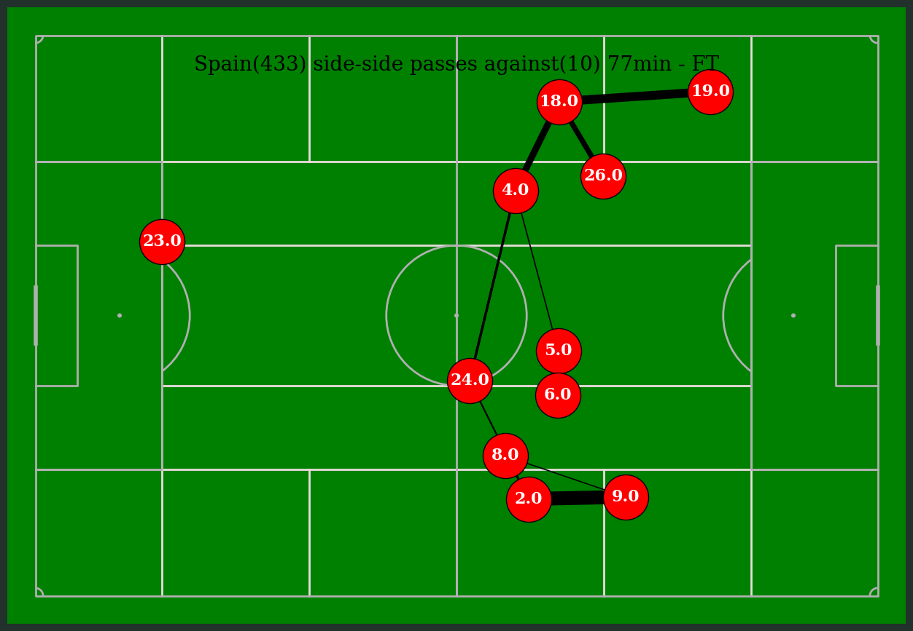
Spain passing map 2nd half from ‘77min
Number | Player
23 | Simon
4 | Torres
24 | Laporte
18 | Alba
2 | Azpilicueta
5 | Busquets
26 | Pedri
19 | Olmo
6 | Llorente
8 | Koke
9 | Moreno
Left side plays back and side to side, but from film, we could see how Switzerland keeps turning back the connection between 2 and 9 while denying 5 & 6

Slide 14
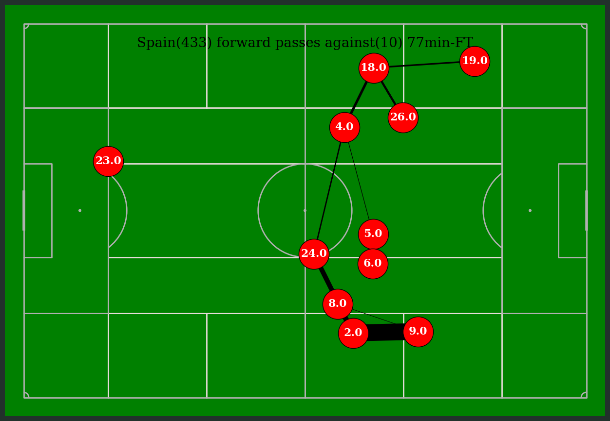
Number | Player
23 | Simon
4 | Torres
24 | Laporte
18 | Alba
2 | Azpilicueta
5 | Busquets
26 | Pedri
19 | Olmo
6 | Llorente
8 | Koke
9 | Moreno
Spain wants to attack from the right, from zone 15 into central areas.
Focus should be played on how to stop 2 from getting clean looks

Slide 15
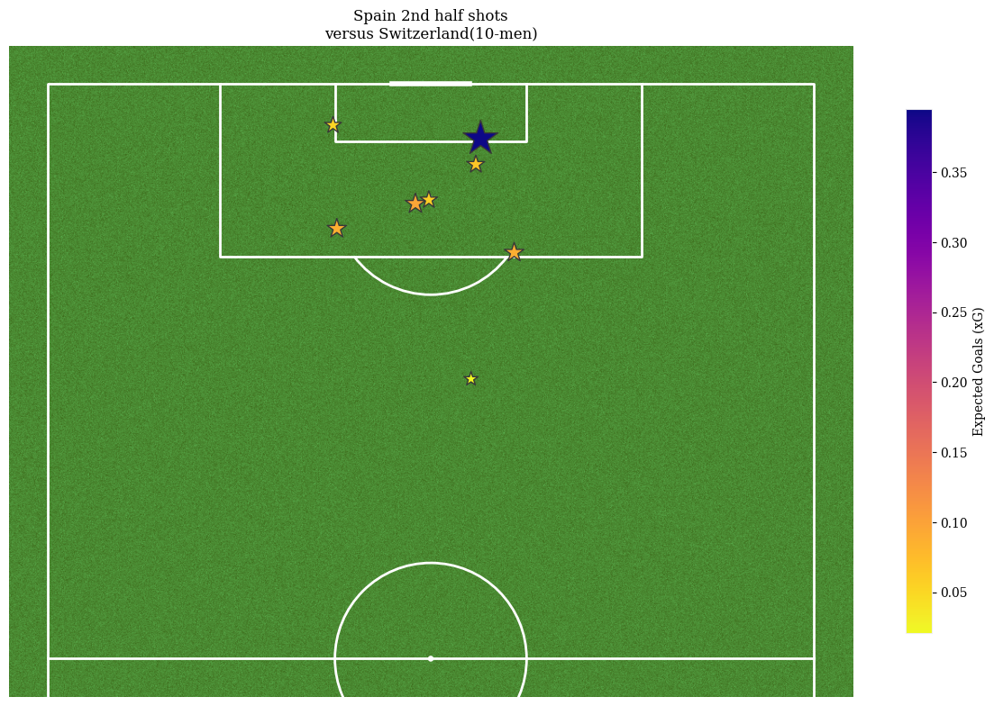
Spain shot map second half
Second half, chasing the game we still see shot discipline from Spain. All but one shot is in the box, and several are in a highly dangerous position. It should be noted that during this time Spain has been criticized for not scoring enough during the tournament.
The lack of poor turnover shots emphasis the commitment to the priority possession play style.

Slide 16
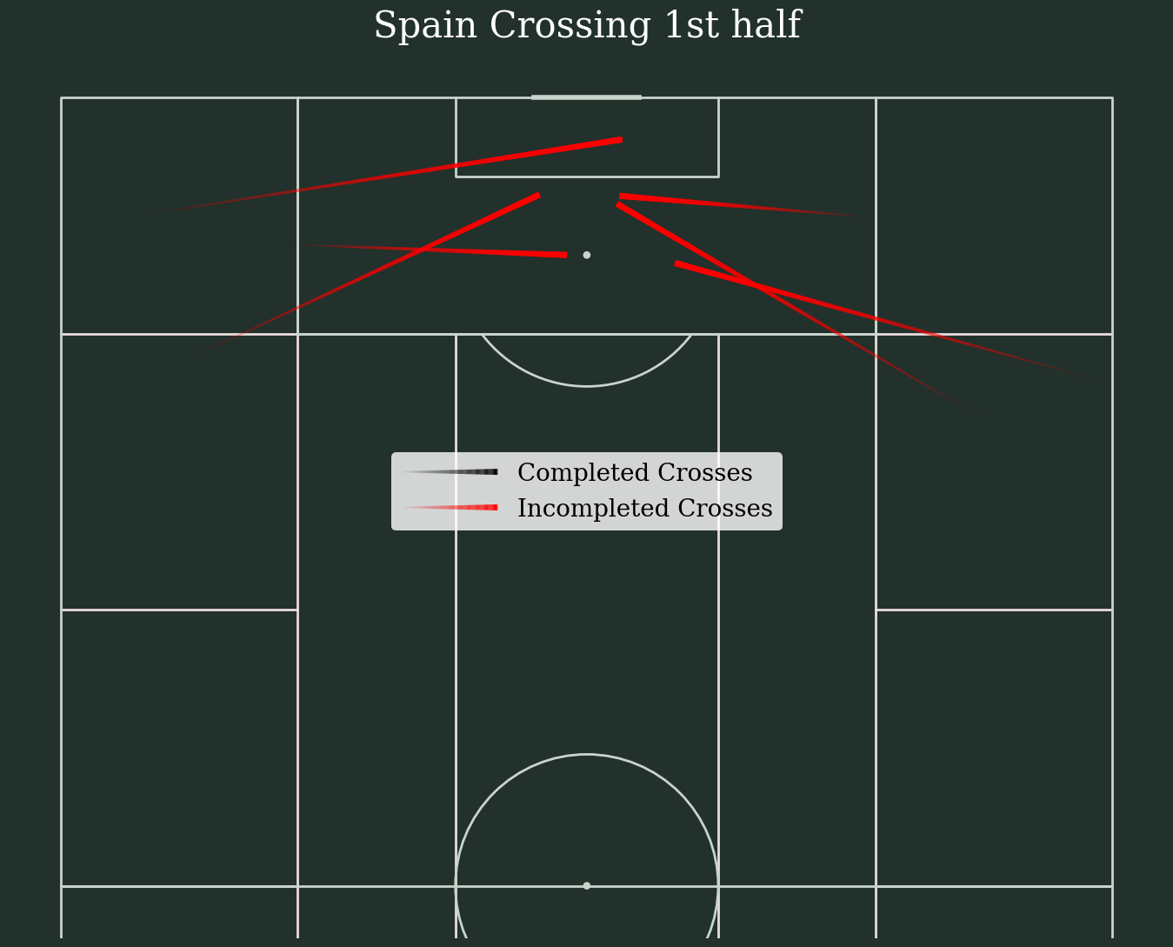
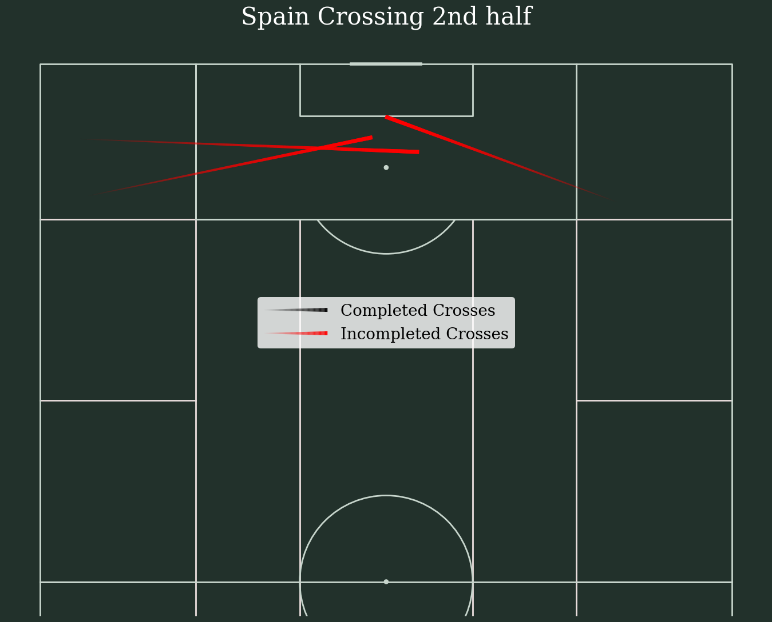
Spain hit crosses in the first half with the lead, but when searching for a goal they all but abandoned crosses as a key chance creation vector

Slide 17
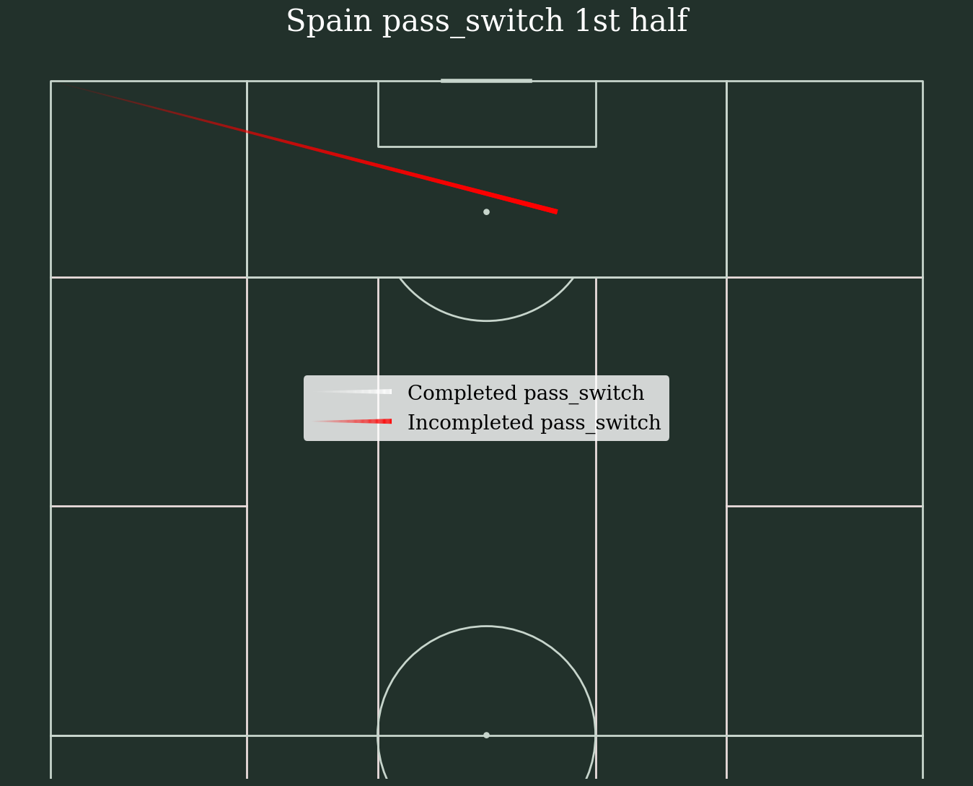
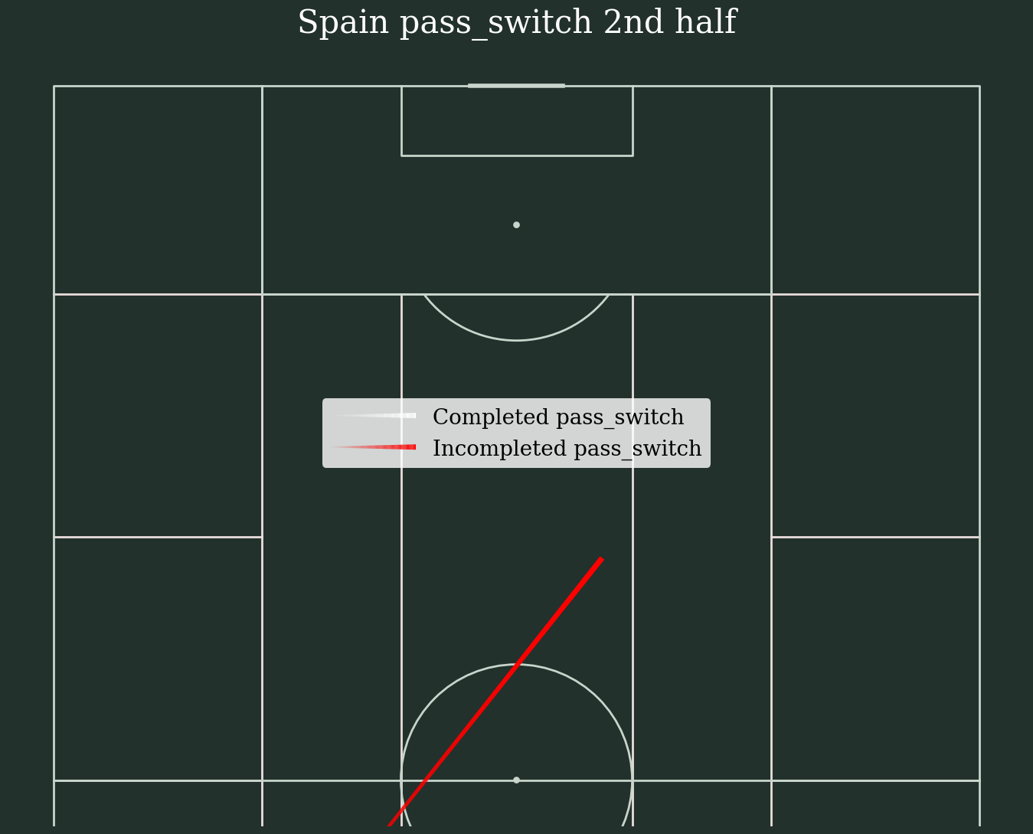
Spain also does not attempt that many long switch passes, harmonizing with the short possession style with lots of small-scale passes.

Slide 18
Ok but how do we make things better?
Interactivity
Dynamically generated and sent content
Made to order analytics
Accelerated analytic processing

Slide 19
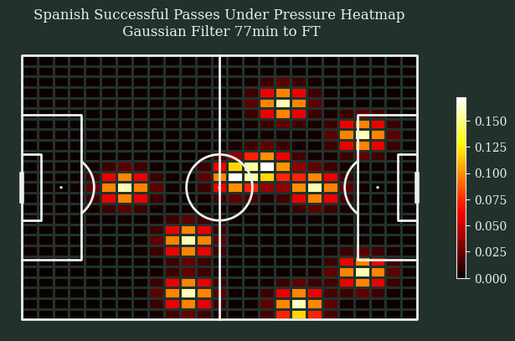
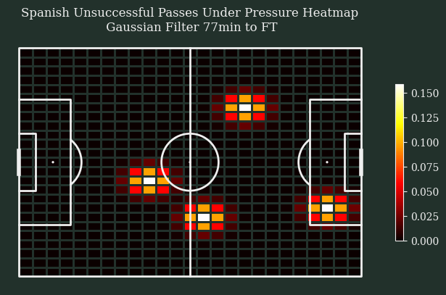
Switzerland post red card pressure map to full time

